Slide 1
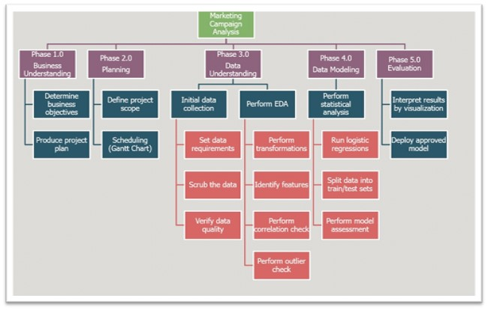
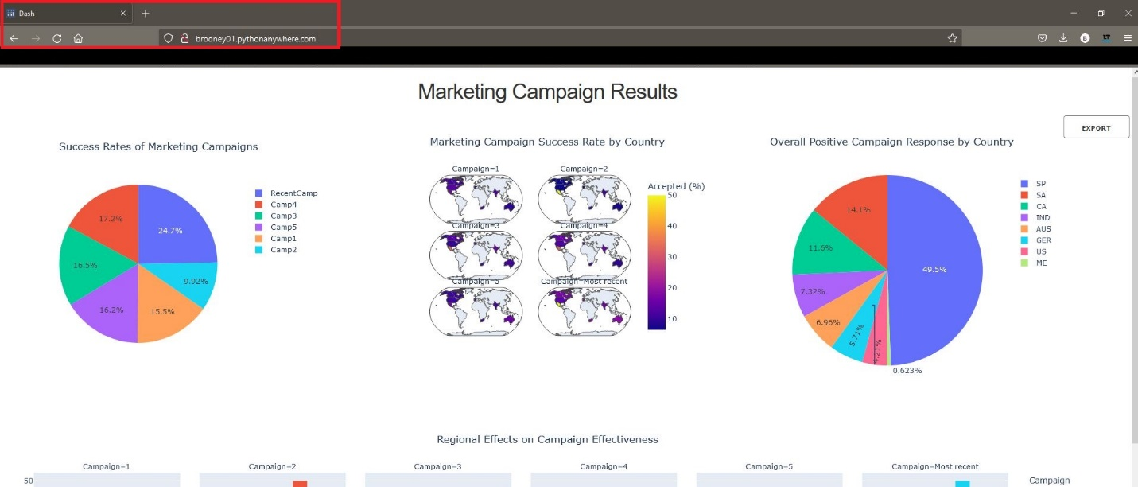
Advisor Name:
Prof. Chintan Thakkar
Grand Canyon University
Analysis of Marketing Campaign Effectiveness
Brian Rodney
Project Goals
Perform statistical and exploratory analysis on recent marketing campaign data to identify the levels of effectiveness.
Construct a customer profile based on clustering and demographic information
Project Flowchart
Outcome Usage
Targeted marketing campaigns
Proactive approach to dynamic marketing
Less wasted resources by identifying trends early
Product churn insights
Methodologies & Tools Used
OLS Regression
Logistic Regression (GLM)
Descriptive Statistics
K-means Clustering
Python 3.9+
Visual Studio Code IDE
Python packages
Pandas, numpy, scikitlearn, dash, seaborn
References
Hair Jr, J. F., & Sarstedt, M. (2021). Data, measurement, and causal inferences in machine learning: opportunities and challenges for marketing. Journal of Marketing Theory and Practice, 29(1), 65-77.
Orlovskyi, D. L., & Kopp, A. M. (2020). A business intelligence dashboard design approach to improve data analytics and decision making (Doctoral dissertation, Stylos).
plotly. (2017, June 21). Introducing Dash - Plotly. Medium. https://medium.com/plotly/introducing-dash-5ecf7191b503
PythonAnywhere (2022). Host, run, and code Python in the cloud: PythonAnywhere. Retrieved from https://www.pythonanywhere.com/
Dashboard product, created with Dash, which displays the results and allows for an export of the data
We would like to acknowledge ....

